Slide 1
Message Authentication

Slide 2
Message authentication is a mechanism or service used to verify the integrity of a msg . It assures that data received are exactly as sent by and that the identity of the sender is valid
  Message authentication may also verify sequencing and timeliness
Digital signature
  An authentication technique that also includes measures to counter repudiation by either source or destination

Slide 3
Authentication Requirements
While communicating across a network ,following attacks can de identified:
1.Disclosure : Release of msg contents to any person or process not pocessing the appropriate cryptographic key
2.Traffic Analysis: Discovery of pattern of traffic between parties.
Connection oriented->frequency and duration of connection
Connection Oriented and Connectionless->number and length of msg’s determined

Slide 4
3.Masquerade msg: Insertion of msg’s into the network from a fraudulent sourcew
4.Content Modification: Changes to the content of a msg; including insertion , deletion,
transposition, modification
5.Sequence Modification: Any modification to a sequence of msg’s between parties
6.Timing Modification: Delay or replay of msg’s.
Connection oriented->entire sequence
Connectionless->individual msg is replayed

Slide 5
7.Source Repudiation: Denial of transmission of msg’s by source
8.Destination repudiation: Denial of Receipt of msg by destination
Measures to deal with first two attacks:
  In the realm of message confidentiality, and are addressed with encryption
Measures to deal with items 3 thru 6
  Message authentication
Measures to deal with items 7
  Digital signature
Measures to deal with items 8
  Combination of Digital signature and a protocol

Slide 6
Authentication Functions
Msg authentication or digital signature has two level of functionality:
Lower level : Some sort of function that produces an authenticator; value used to authenticate a msg
Higher Level : Enables a receiver to verify the authenticity of msg

Slide 7
Value used to authenticate a msg can be grouped into 3 classes:
Message Encryption : Ciphertext of the entire msg serves as the authenticator
Message authentication code(MAC):Function of the msg and a secret key produces a fixed length value that serves as the authenticator
Hash Function : Function that maps a msg of any length into a fixed length hash value , which serves as the authenticator

Slide 8
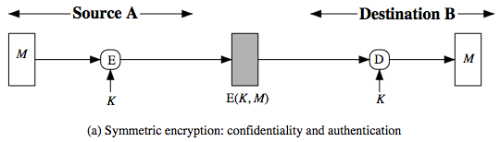
Message Encryption
Encryption itself provides an authentication
Symmetric Encryption:

Slide 9
Message M transmitted from source A to destination B is encrypted using a secret key K shared by A and B
If no other party knows the key, confidentiality is provided
B is assured that msg was generated by A, because K is the only party that posses K
So confidentiality and authentication
We can add a checksum to each msg before or after encryption

Slide 10
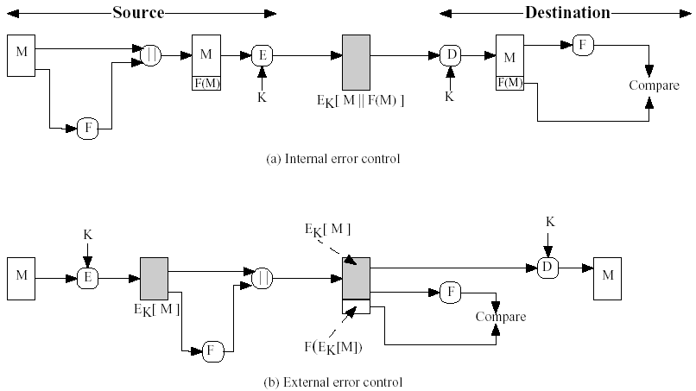

Slide 11
Public Key Encryption
To provide both confidentiality and authentication, A can encrypt M first using its private key, which provides digital signature and then using B’s public key which provides confidentiality
Drawback : Public key encryption ,which is complex is used many times

Slide 12
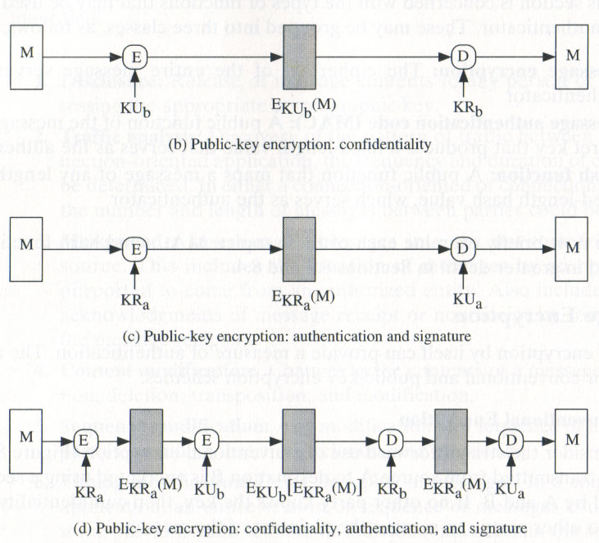

Slide 13
Message Authentication Code
Authentication technique
Use a secret key to generate a small fixed-size block of data->checksum or MAC,that is appended to the message
Two communication parties A and B,share a common secret key K.
When A has a msg to send to B,it calculates MAC as a function of the msg and the key: MAC=C(K,M)
M->input msg
C->MAC function
K->shared secret key
MAC->Msg authentication code

Slide 14
Msg plus MAC are transmitted to intended receiver
Recipient performs same calculation on the received msg, using the secret key to generate a new MAC
Received MAC is compared to the calculated MAC
If the received MAC matches the calculated MAC, then
The receiver is assured that the msg has not been altered
The receiver is assured that the msg is from the alleged sender

Slide 15
3.If the msg includes a sequence number, receiver can be assured of the proper sequence because an attacker canno9t successfully alter the sequence no:

Slide 16
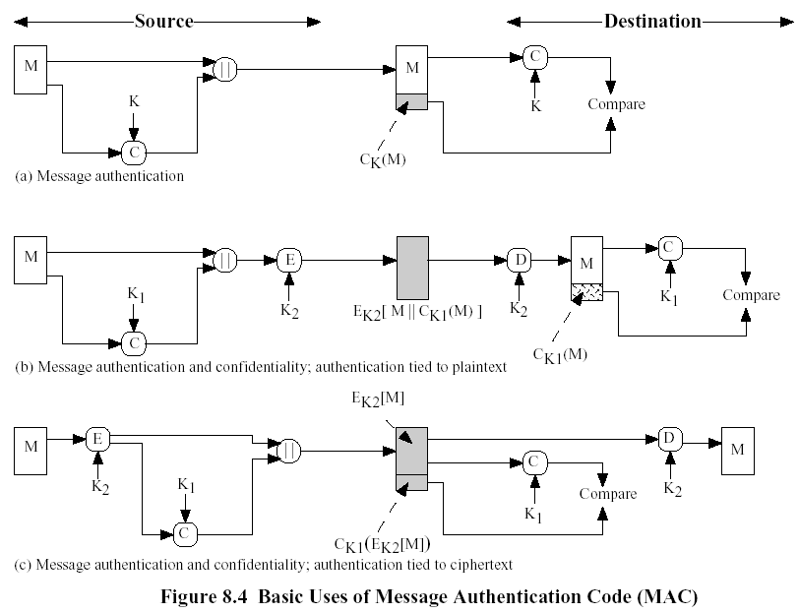

Slide 17
Hash Function
Hash function accepts a variable size msg as i/p and produces a fixed size output ->hash code(H(M))
Hash code does not use a key but is a function only of the i/p msg
Hash code is referred as message digest or hash value
Provides error detection capability

Slide 18
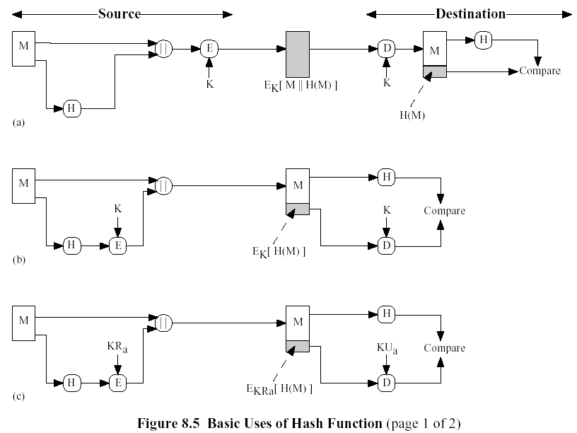
Uses Of Hash Function

Slide 19
SymmetricEncryption: Authentication+Confidentiality
Here msg +hash code encrypted using symmetric key encryption
b)Hash code is encrypted using symmetric encryption
Reduces processing burden for applications that do not require confidentiality
c)Hash code is encrypted using public key encryption and use of senders private key provides authentication

Slide 20
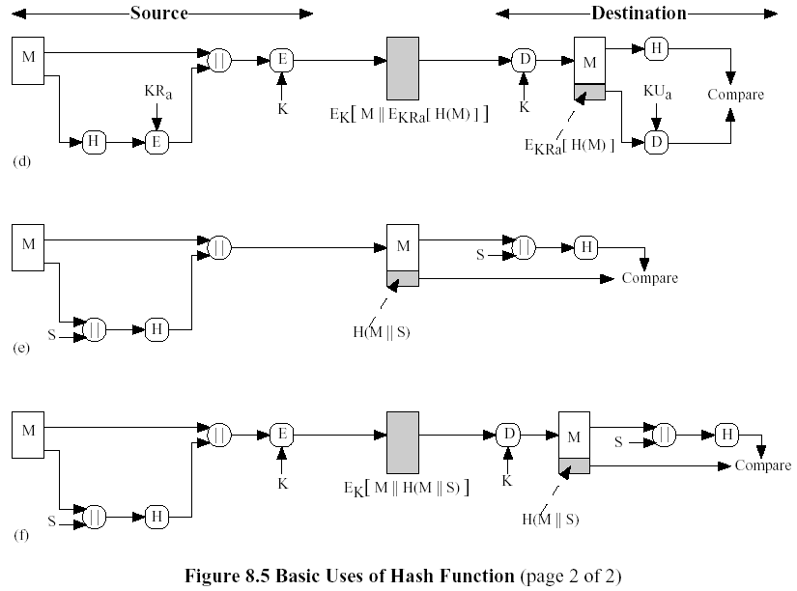

Slide 21
d)Hash code is encrypted using public encryption. This plus msg is again encrypted using a symmetric secret key. It provides confidentiality + digital signature
e)It uses a hash function, but no encryption is performed . Here two parties share a common secret value ‘S’ .’A’ compute the hash value using this ’S’ and appends the resulting hash value to M.B uses the same S value and recompute the hash value and compare
Since the secret value itself is not sent an opponent cannot modify and generate a false msg

Slide 22
f)Here confidentiality is provided by encrypting the entire msg+hash code

Slide 23
Message Authentication Codes
Also known as cryptographic checksum
Generated by a function C of the form
MAC=C(K,M)
M->variable length msg
K->secret key shared only by sender & receiver
C(K,M)->fixed length authenticator
MAC is appended to the msg at the source
Receiver authenticates the msg by recomputing the MAC

Slide 24
MAC is irreversible, but encryption isn’t.
  1. Alice and Bob share the secret K1.
  2. Alice calculates MAC₁ = C_{K1}(M)
Alice→Bob: {M, MAC₁}
  3. Bob calculates MAC₂ = C_{K1}(M)
  If MAC₂ = MAC₁, M is sent from Alice and not altered
Confidentiality can be provided by encryption with another shared key.
Alice→Bob: {M, MAC₁}_{K2}

Slide 25
Requirements For MAC’s
If an opponent observes M and C_{K}(M), it should be computationally infeasible to construct M’ such that C_{K}(M’) = C_{K}(M).
C_{K}(M) should be uniformly distributed in the sense that for randomly chosen messages, M and M’, the probability that C_{K}(M) = C_{K}(M’) is 2^{-n}, where n is the number of bits in the MAC.
Let M’ be equal to some known transformation on M. That is, M’ = f(M). E.g. f may involve inverting one or more specific bits.
In that case, Pr[C_{K}(M) = C_{K}(M’)] = 2^{-n}.

Slide 26
Message Authentication Code Based on DES
A widely used MAC can be defined by using cipher block chaining (CBC)mode of operation of DES with an initializing vector of zero
Data to be authenticated are grouped into contiguous 64 bit blocks
Final block is padded with zeros on the rgt side to form full 64bit block

Slide 27
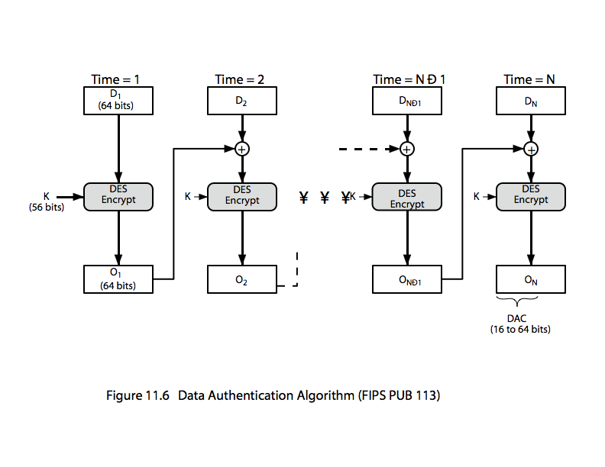

Slide 28
Hash Functions
A (one-way) hash function accepts a variable-size message M as input and produces a fixed-size hash code H(M) as output (called Message Digest)
Hash code provides error detection -> a change in one bit of message results in a change to the hash code

Slide 29
Requirements for a Hash Functions
H can be applied to a block of data of any size.
H produces a fixed-length output.
It is easy to compute H(x) from any given x.
For any given h, computationally infeasible to find x, where H(x) = h (“one-way property”)
For any x, computationally infeasible to find y, y≠x, H(y) = H(x) (“weak collision resistance”)
Computationally infeasible to find any pair of (x, y) such than H(x) = H(y) (“strong collision resistance”)

Slide 30
Birthday Attacks
might think a 64--bit hash is secure
• birthday attack works thus:
Source A is prepared to ‘sign’ a msg by appending the appropriate m-bit hash code and encrypting that hash code with A’s private key
Opponent generates 2^{m/2} variations on the msg , all of which convey essentially the same meaning. Opponent prepares equal number of messages, all of which are variations on the fraudulent msg to be substituted for real one

Slide 31
3.Two sets of msg’s are compared to find a pair of msg’s that produces the same hash code. The probability of success is greater than 0.5.If no match is found, additional valid and fraudulent msgs are generated until a match is made
4.Opponent offers a valid variation to A for signature. This signature can then be attached to the fraudulent variation for transmission to the intended recipient. Because the two variations have same hash code; they will produce same signature; opponent is assured of success even though key not known

